Slide 1
Autonomous Cars
Daria Zahaleanu

Slide 2
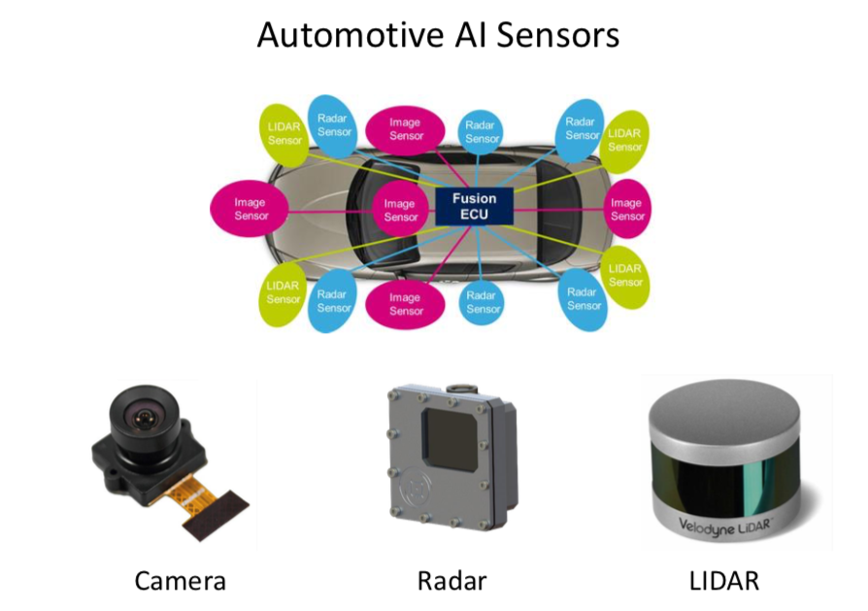
Why are ACs vulnerable to cyber attacks?
Electronic sensors commanded remotely using software
Increase in communication channels
Possible attack consequences:
Manipulation of biometric authentication
Car crashes
Theft of illicit or illegal content
Source: MIT

Slide 3
Adversarial Goals and Capabilities
Goals:
Confidence reduction
Misclassification
Targeted misclassification
Source/target misclassification
Notes:
Confidence reduction - reduce the output confidence classification (thereby introducing class ambiguity)
2) Misclassification - alter the output classification to any class different from the original class
3) Targeted misclassification - produce inputs that force the output classification to be a specific target class. Contin- uing the example illustrated in Figure 1, the adversary would create a set of speckles classified as a digit.
4) Source/target misclassification - force the output clas- sification of a specific input to be a specific target class. Continuing the example from Figure 1, adversaries take an existing image of a digit and add a small number of speckles to classify the resulting image as another digit.

Slide 4
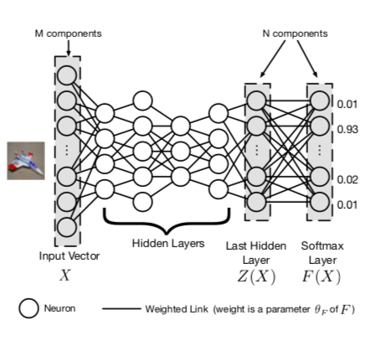
Neural Network Model
Neurons
Weight 𝛳
DNN Architecture
Source: Papernot et al.

Slide 5
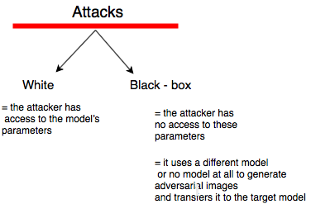
Attack Taxonomy
Notes:
The multitude of potential threats and vulnerabilities that an AV may encounter requires a rigorous classification of these, based on the type of attackers, the attack vector, target, motive and potential consequences. Therefore, while the physical attacks may be more familiar to the readers, the remote-access ones are the most prevalent and harmful nowadays (Figure 1). The physical non-invasive attacks, also known as side-channel attacks represent the most trivial and outdated attacks, that collect data about power consumption, electromagnetic leaks, acoustic signal analysis and data remanence that reveal valuable information about the performance of the vehicle. On the other side, the physical invasive attacks include more refined methods of attacks, such as code modification; code injection where malicious payloads infiltrate AVs; packet sniffing where the target is represented by packets of data are transmitted over the Internet; packet fuzzing, where invalid data is sent to the target system; in-vehicle spoofing, often represented by spam emails. [1]
The remote-access attacks use the enhanced connectivity to collect or inject information from/to LiDARs, cameras or GPS. The most harmful external signal spoofing is the GPS spoofing that occurs when erroneous, deceiving information is fed into the GPS of an AV, by drifting off the path of the car. Jamming attacks are attacks against the wireless medium and external facing sensors, such as LiDARs or cameras, where a jammer device blocks the sensors from receiving signals. [1]

Slide 6
Types of Attacks
Defensive Distillation
Robust Physical - World Attacks
Black - Box Attack

Slide 7
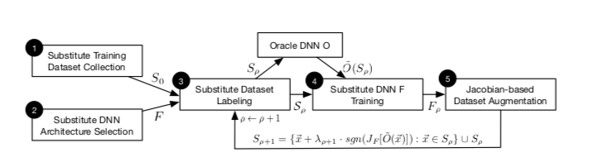
Black-Box Attacks
in black-box attacks, the adversary doesn’t have any knowledge about the model, except for the the labels
the goal is to produce a minimal perturbation to input X, sufficient to determine the DNN to misclassify it, but imperceptible enough for the human eye
approach: use DNN as an oracle to synthesized data and generate a synthetic data set S0 to build a model F that approximates the oracle’s decision
Source: Papernot et al.
Notes:
Unlike the other two type of attacks, classified as white-box attacks, as the adversary has full access to the internal structure of the classifier, in black-box attacks, the adversary doesnâ€™t have any knowledge about the model, except for the the labels, the allow him/her access to the output only. The goal is as we previously saw, to produce a minimal perturbation to input X, sufficient to determine the DNN to misclassify it, but imperceptible enough for the human eye. The approach to this type of attack is as following: use DNN as an orale to synthesized data and generate a synthetic data set S0 to build a model F that approximates the oracleâ€™s decision. Then using the new architecture F to craft adversarial samples, the oracle outputs a misclassified probability vector, corresponding to input X*. This step, called substitute DNN training algorithm, ends with the Jacobian-based dataset augmentation, which generates a new set of data S (Figure 7). Once the adversary training a substitute DNN, it uses it to craft adversarial samples, by using two types of algorithms: Goodfellow, or the fast gradient sign method and Papernot. Therefore, the black-box attack generalizes to machine learning models that are not necessarily DNNs, regardless of the differentiability of the functions.

Slide 8
Simulators
Udacity & Carla

Slide 9
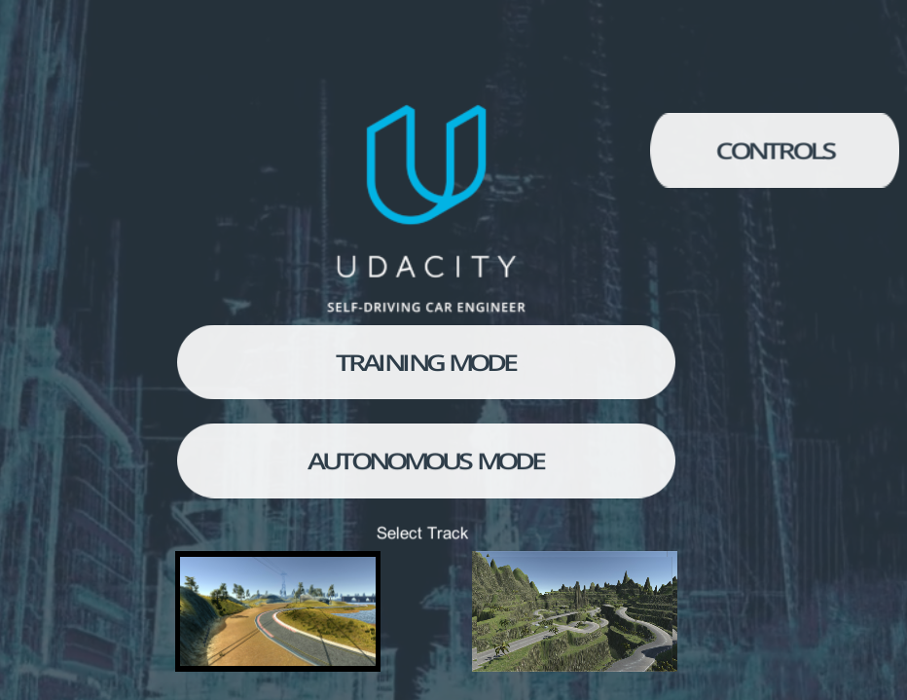

Slide 10
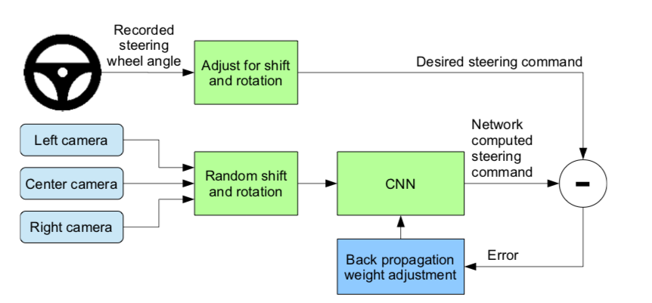
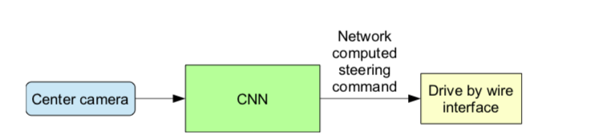
Udacity Self-driving Car Simulator

Slide 11
Udacity Neural Network Model
The model has 9 layers, including a normalization layer, 5 convolutional layers and 3 fully connected layers.
Image normalization
Convolution: 5x5, filter: 24, strides: 2x2, activation: ELU
Convolution: 5x5, filter: 36, strides: 2x2, activation: ELU
Convolution: 5x5, filter: 48, strides: 2x2, activation: ELU
Convolution: 3x3, filter: 64, strides: 1x1, activation: ELU
Convolution: 3x3, filter: 64, strides: 1x1, activation: ELU
Drop out (0.5)
Fully connected: neurons: 100, activation: ELU
Fully connected: neurons: 50, activation: ELU
Fully connected: neurons: 10, activation: ELU
Fully connected: neurons: 1 (output)

Slide 12
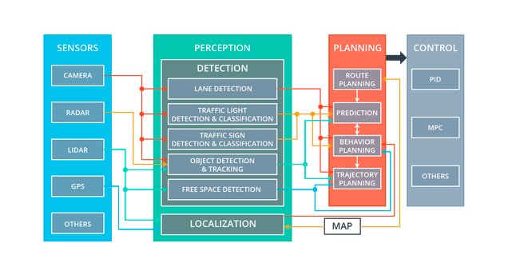
Carla Simulator

Slide 13
Black - box Attack
One Pixel Attack

Slide 14
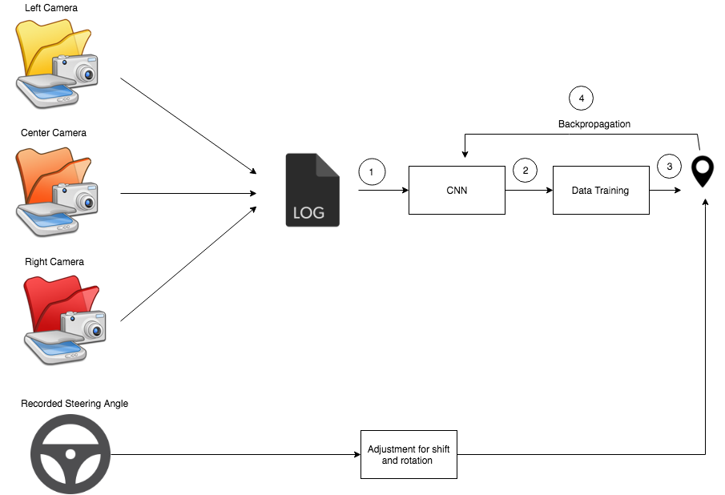
Attack Scheme
ONE PIXEL ATTACK - Adding noise to the images collected from the 3 cameras
Sending adversarial samples to the neural network
Sending adversarial samples after the training of the data
Adding perturbations to the backpropagation process

Slide 15
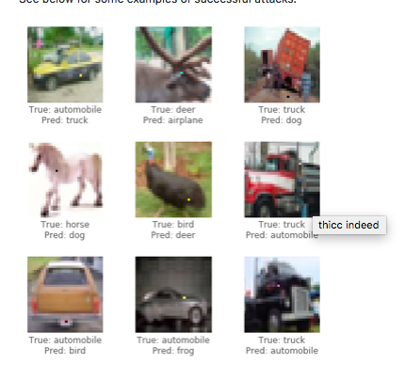
One Pixel Attack
It uses a CIFAR dataset is to correctly classify a 32x32 pixel image in 1 of 10 categories (e.g., bird, deer, truck).
The black-box attack requires only the probability labels (the probability value for each category) that get outputted by the neural network.

Slide 16
One Pixel Attack
Model
First, generate several adversarial samples that modify a random pixel and run the images through the neural network.
Next, combine the previous pixels' positions and colors together, generate several more adversarial samples from them, and run the new images through the neural network.
If there were pixels that lowered the confidence of the network from the last step, replace them as the current best known solutions.
Repeat these steps for a few iterations; then on the last step return the adversarial image that reduced the network's confidence the most.
If successful, the confidence would be reduced so much that a new (incorrect) category now has the highest classification confidence.

Slide 17
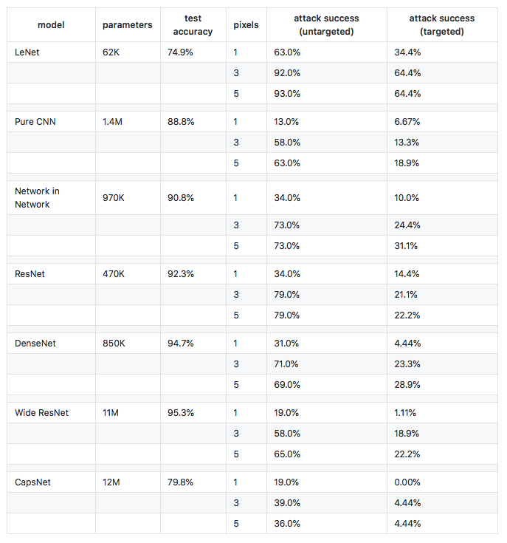
Results of the attack on different neural networks

Slide 18
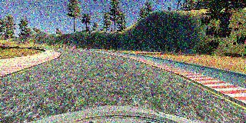
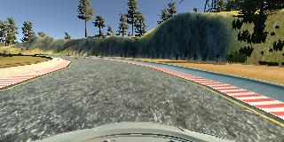
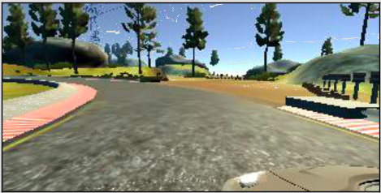
Normal vs. Noisy

Slide 19
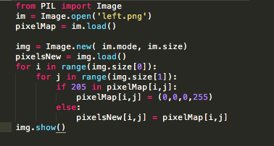
Attack Code
Notes:
Definition, training, query

Slide 20
Results for Udacity
Data gets trained
Autonomous Mode doesn’t work

Slide 21
Future Work
Find ways to make the autonomous mode work
Quantify the how the perturbations affect the autonomous mode

